Slide 1
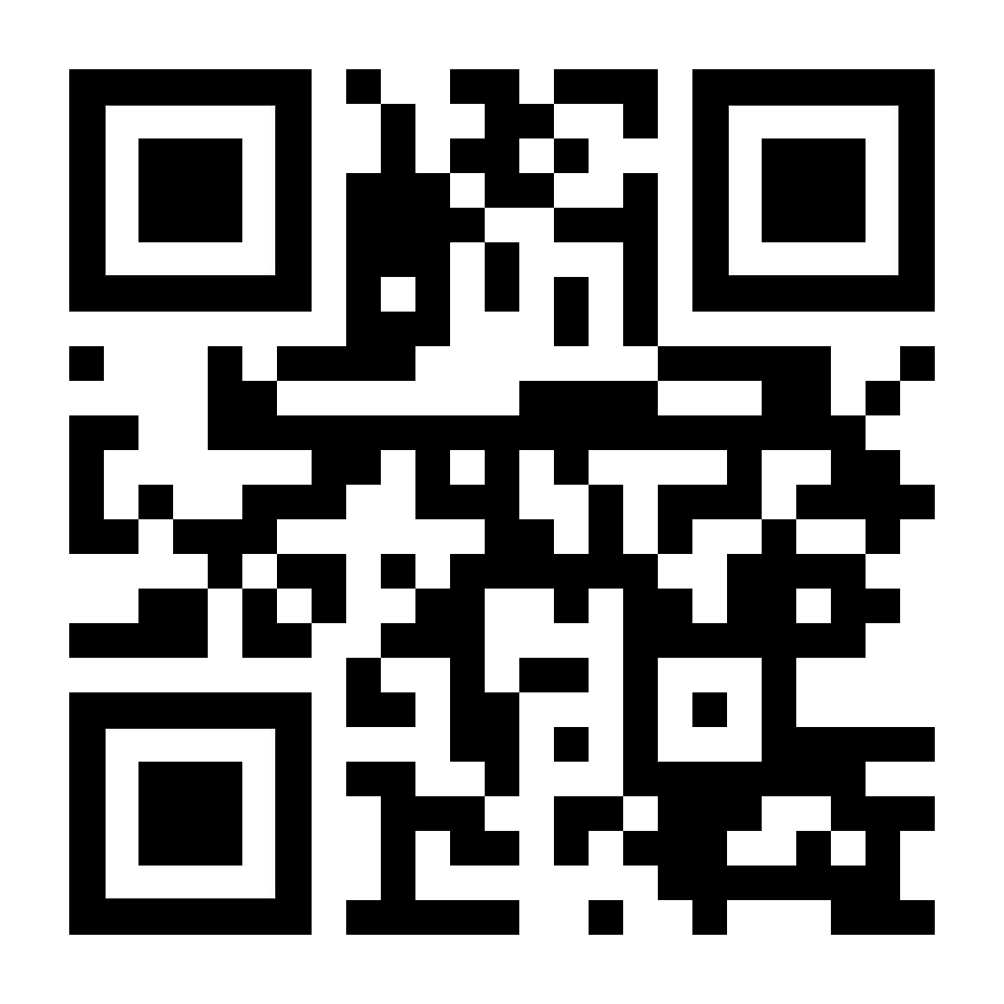
SQL Server DevOps
SQL Saturday Richmond – 2024
George Walkey
PatientFirst Corp

Slide 2
Agenda
Org Setup
Project Setup
Service Connection
Build Pipeline Construction
Release Pipeline Construction
Live Demo of SQL DB Project Schema change

Slide 3
DevOps Organization
Established at Account Creation
New Organization

Slide 4
Project Setup
Go to Organization Settings
General, Projects
+ New Project

Slide 5
Service Connection
Is the Link between your Project and your Azure Resources
WebApps
SQl Databases
Create Service Connection
Azure Resource Manager
Workload Identity federation
Pick your subscription
Pick a Resource Group

Slide 6
Create Build Pipeline
Follow Syllabus at
https://github.com/gwalkey/Azure-SQL-DevOps
Create Agent Job with 3 Tasks
Visual Studio Build
Copy Files
Publish Build Artifacts

Slide 7
Create Release Pipeline
Add Artifact from Build Pipeline – “the Hookup”
Edit Agent Job
Add Azure SQL Database Deployment task
Setup optional Keyvault for SQL admin username/passwords
Setup SQLPackage.EXE options
Enable CI/CD Trigger
Add optional Approvals and Notifications

Slide 8
Notes
This build pipeline example uses the “Classic Editor” not YAML
YAML requires a get-provider repo type, VSTS/TFS not suppoted
You can trigger a build by editing the repo files directly
You *CAN* use DevOps pipelines to deploy to on-prem servers with local agents

